Slide 1
Instructions for Taskstream Access
Arkansas State University
Office of Assessment

Slide 2
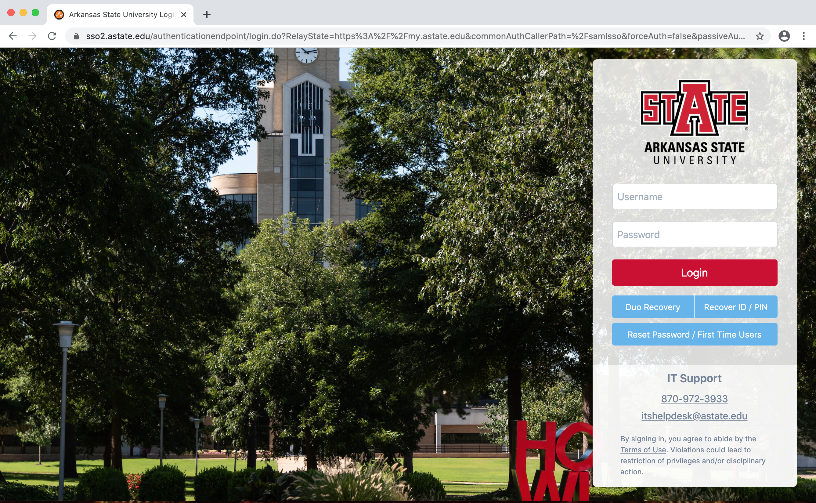
Step 1
Log into your MyAstate account

Slide 3
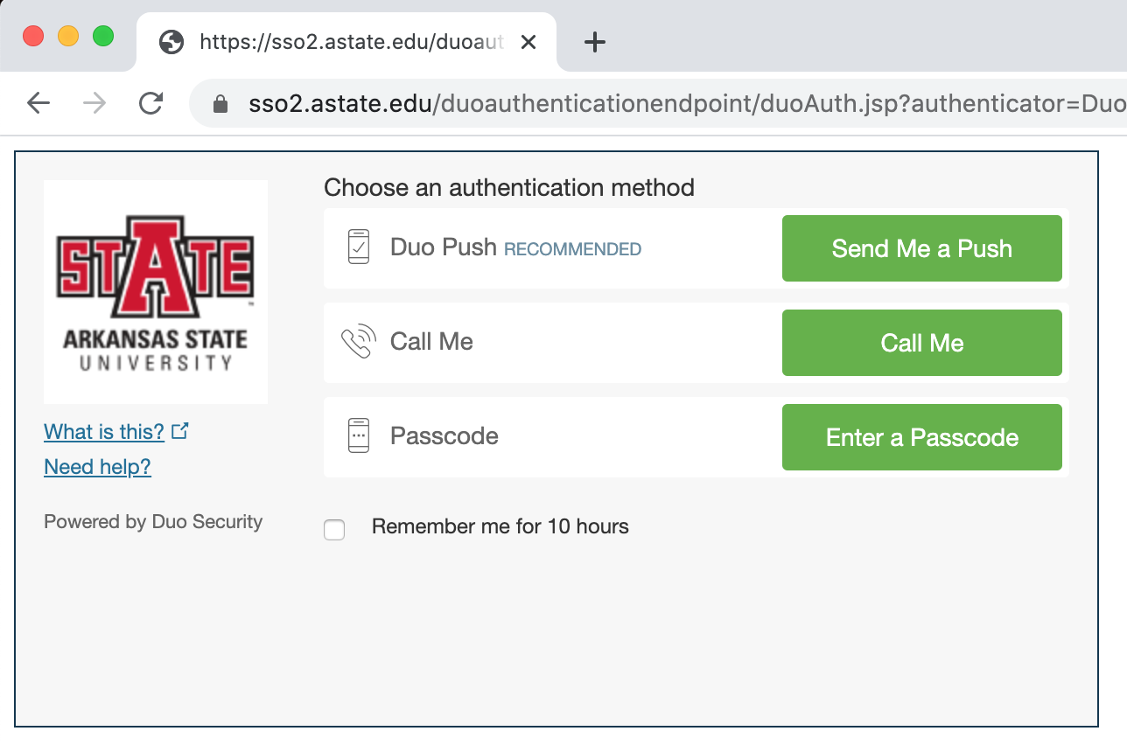
Step 2
Complete the DuoPush login prompt.

Slide 4
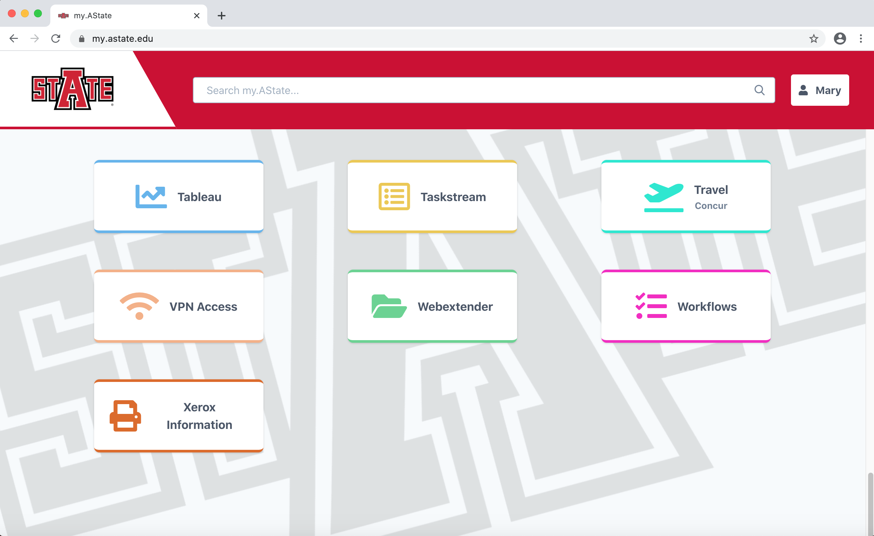
Step 3
Locate and click the Taskstream Icon.

Slide 5
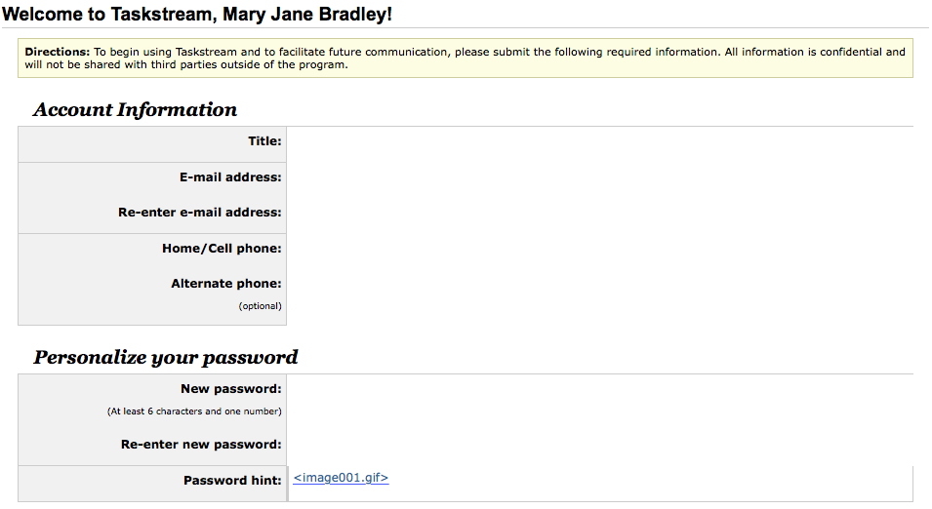
Step 4
You will be directed to the Taskstream website and you will complete the following information:

Slide 6
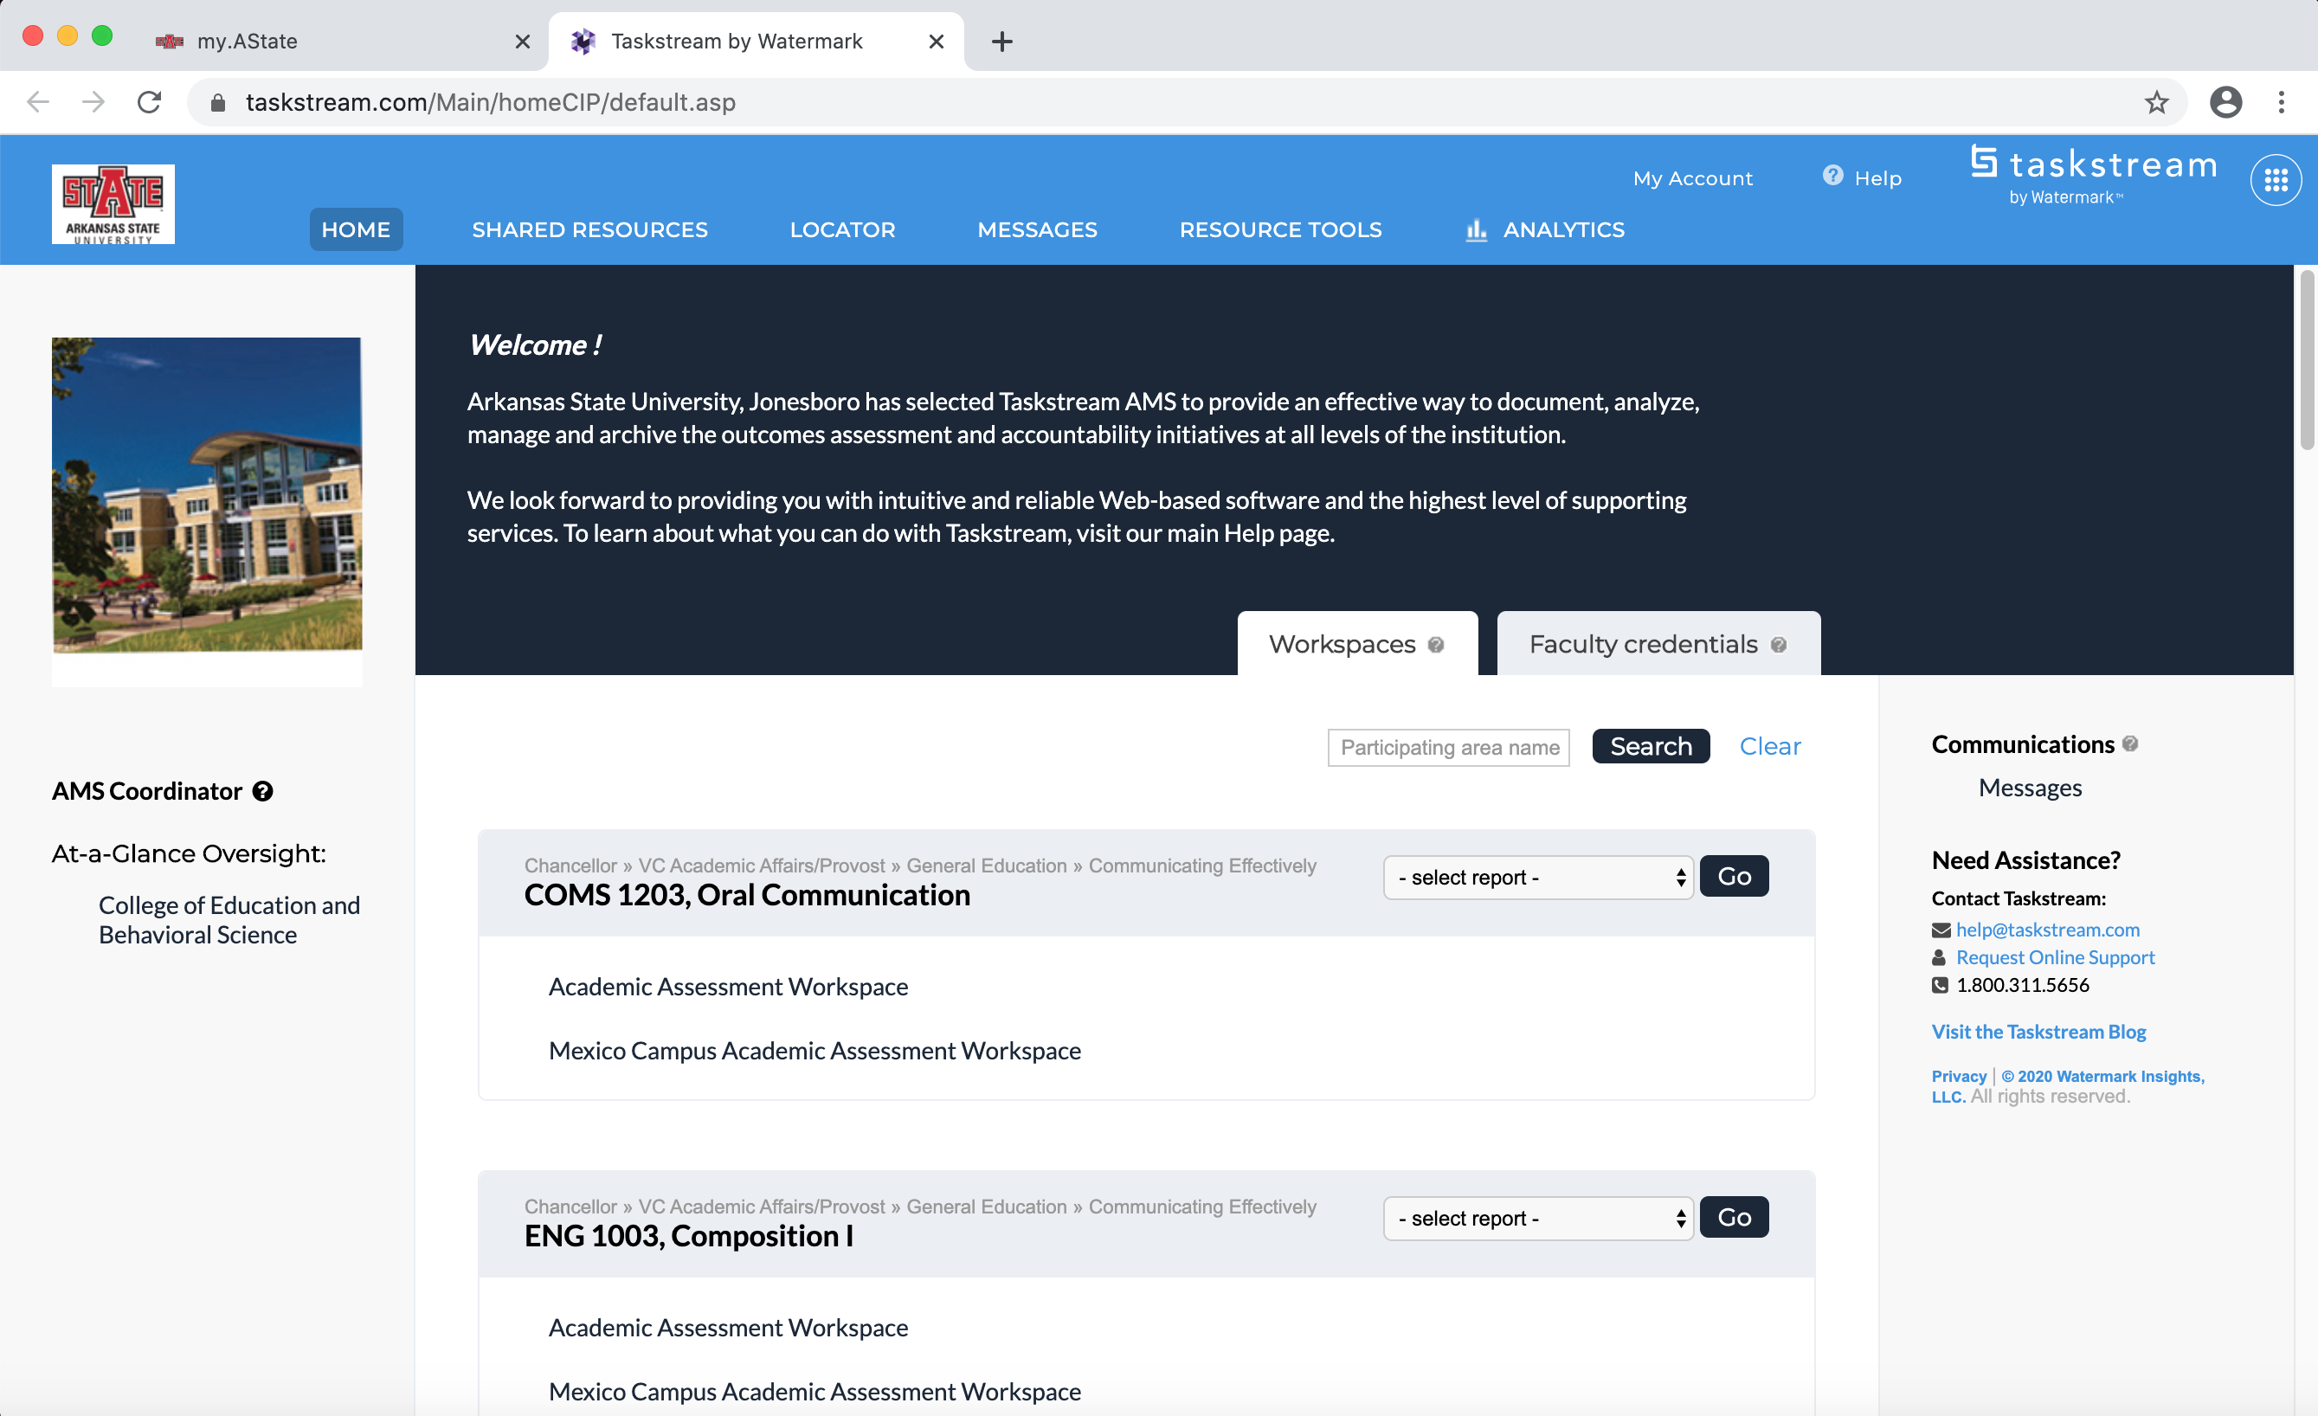
Step 5
Click on the workspace link to input data

Slide 7
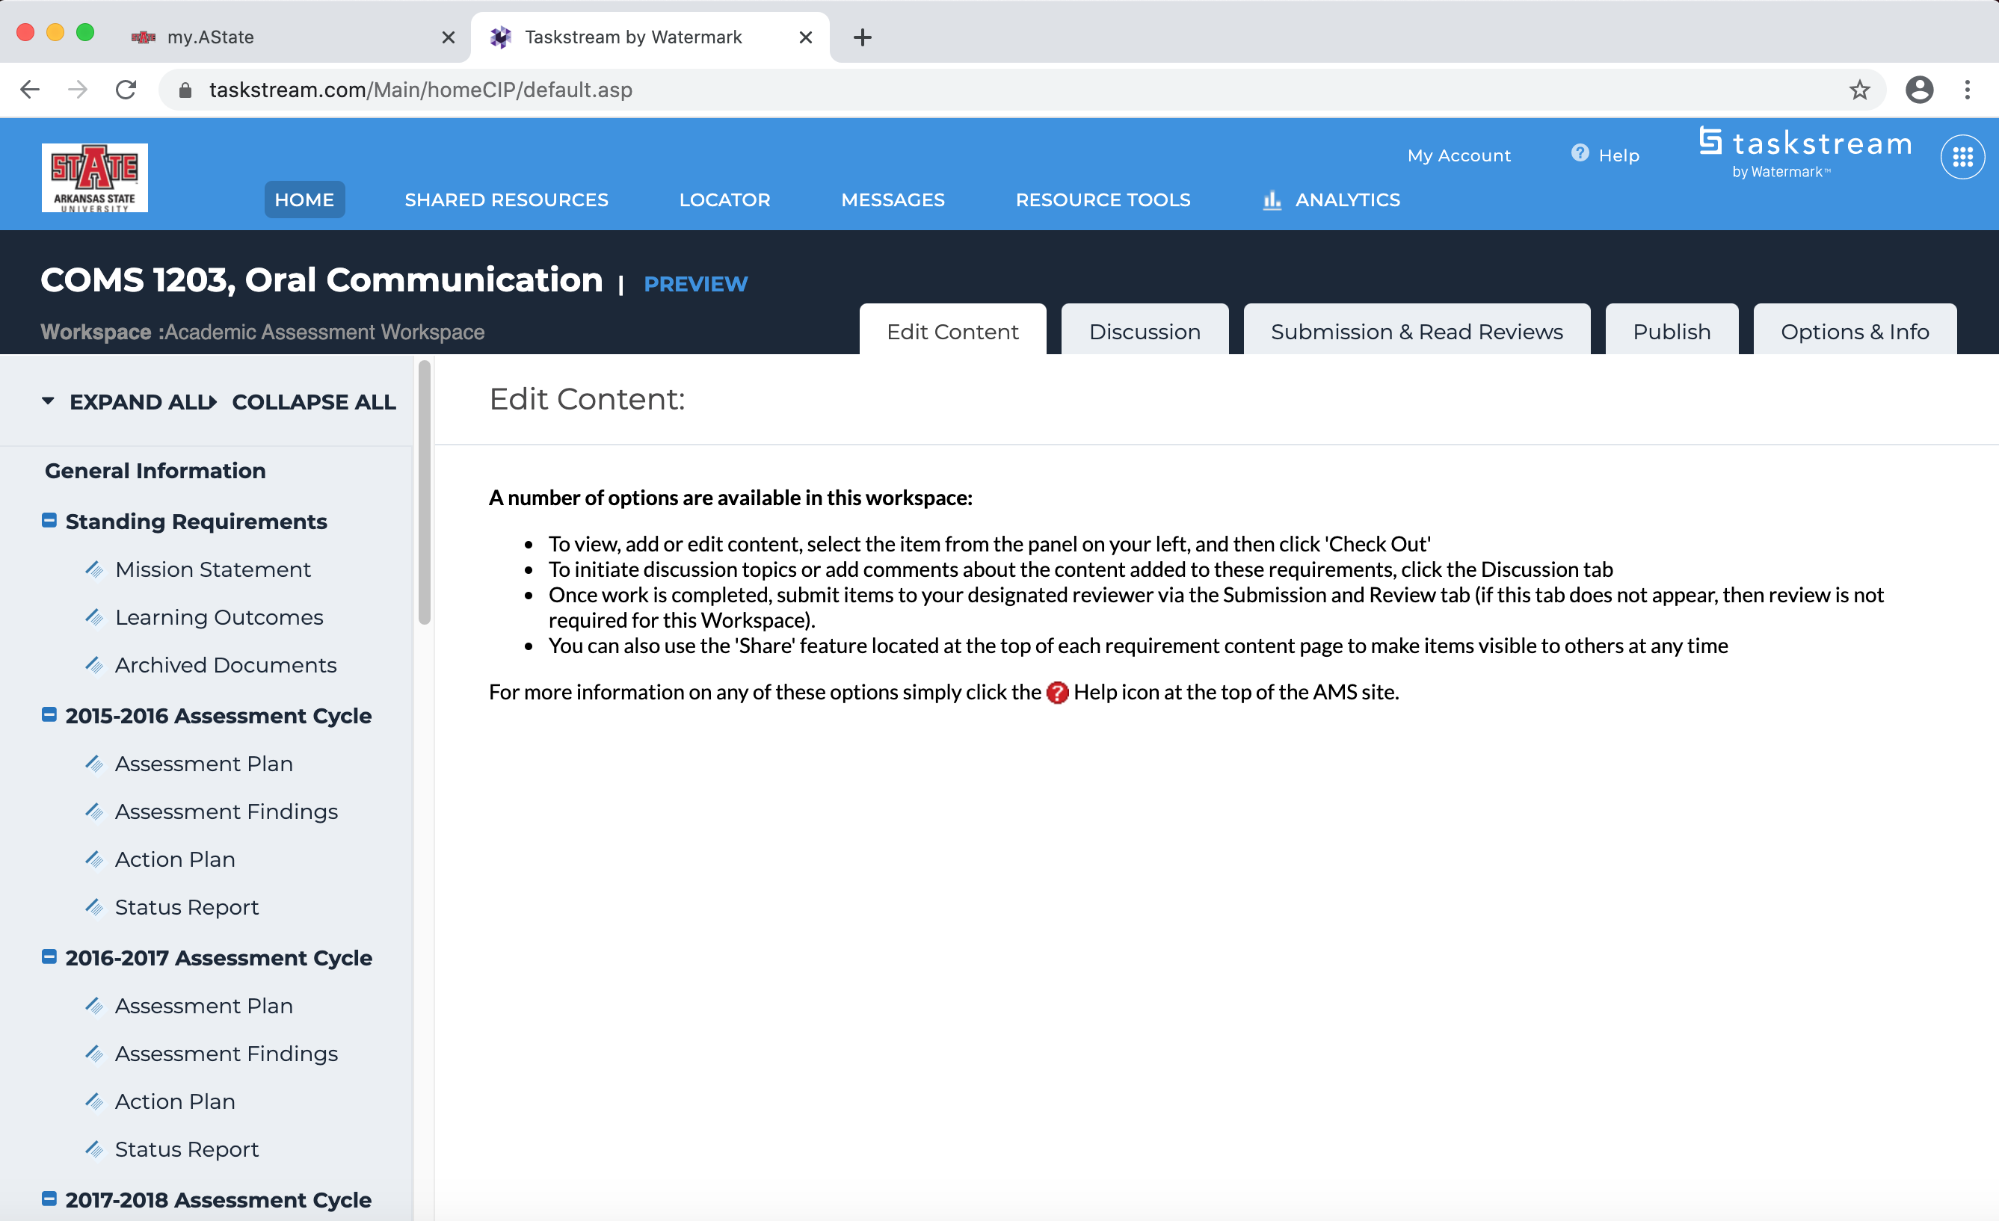
Step 6
This is the initial screen you will see

Slide 8
Contact Information
Please contact the Office of Assessment if you have problems.
Extension 2989
mspence@astate.edu

